Slide 1
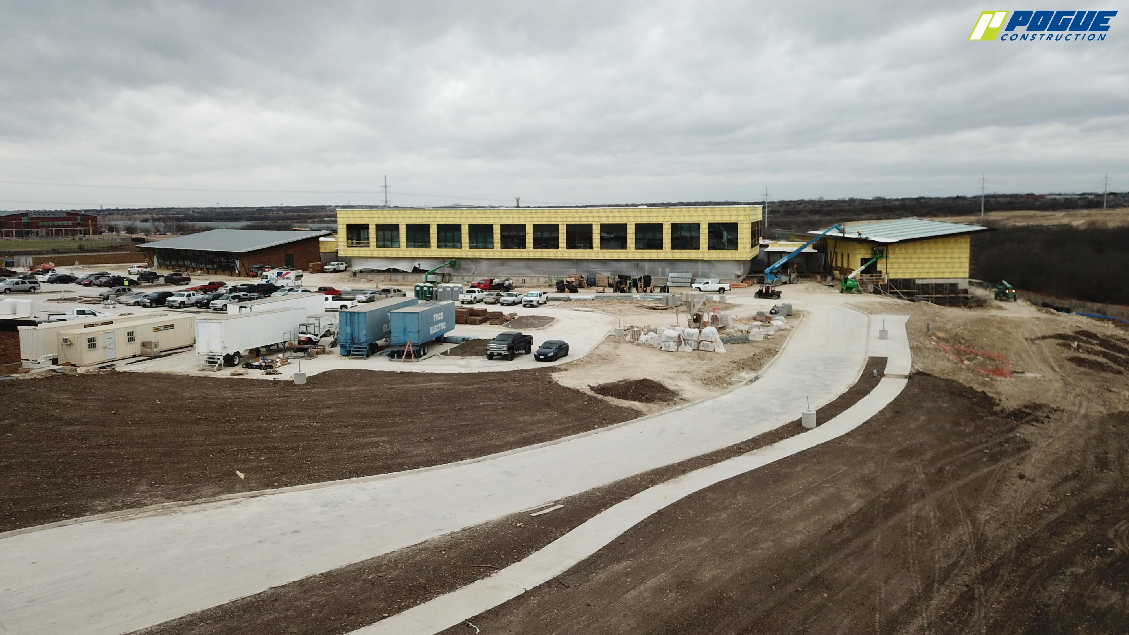
NEW ADMINISTRATION BUILDING
Final landscape grade is in progress around the west and south sides of the building.

Slide 2
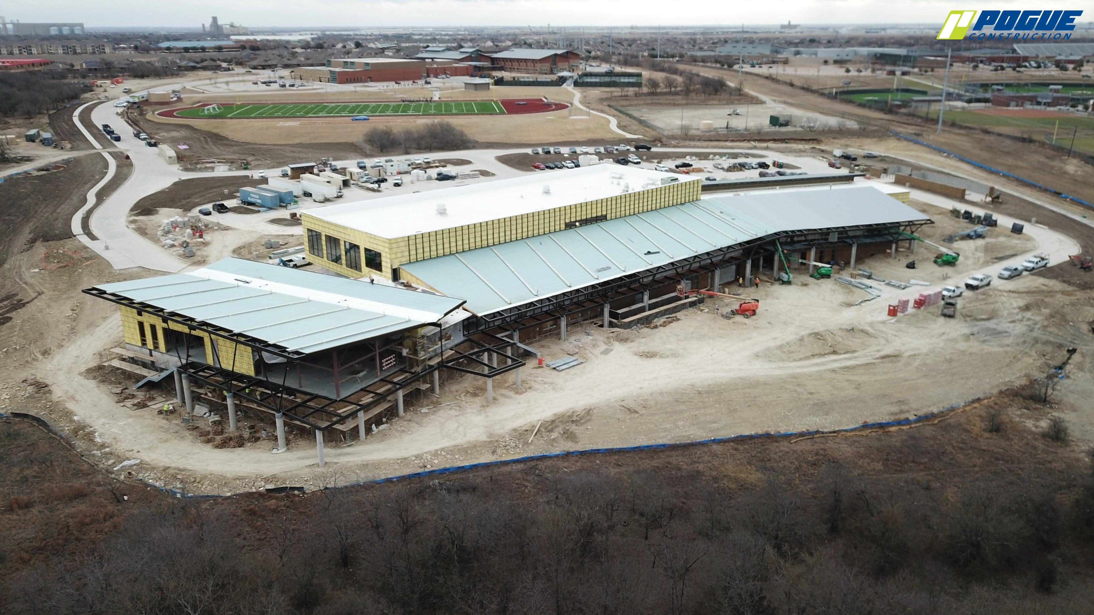
Metal roof is near completion in Areas A, B, and C.

Slide 3
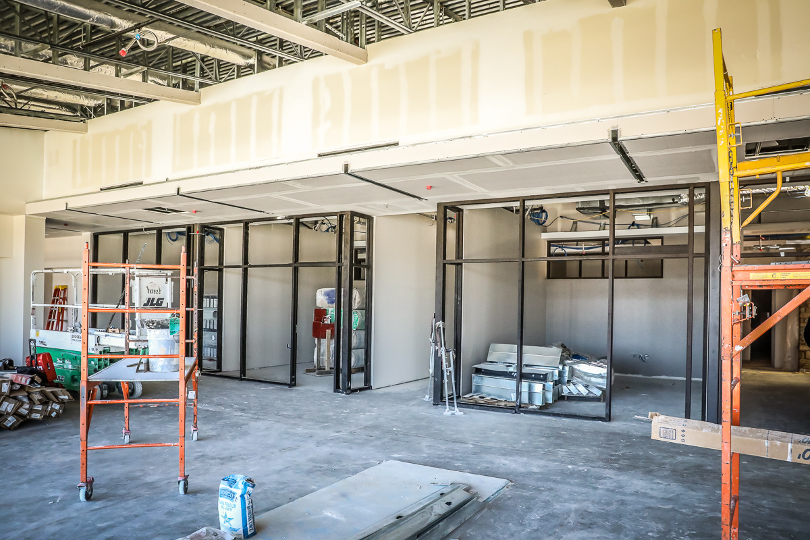
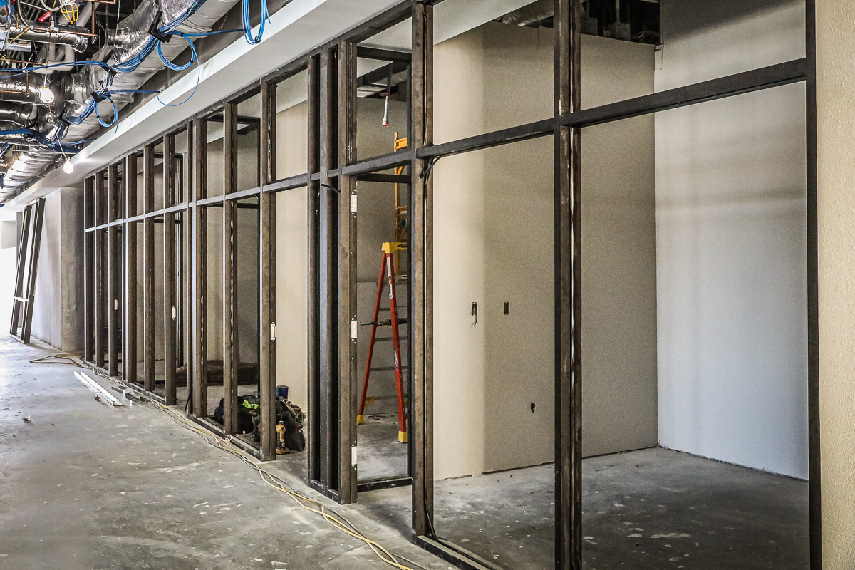
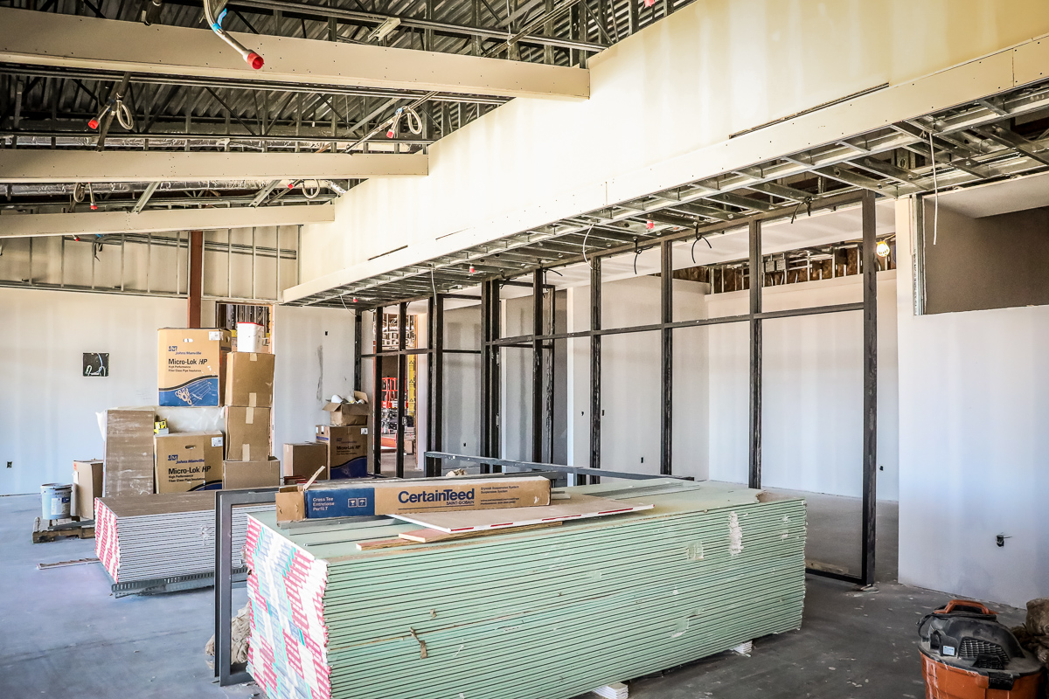
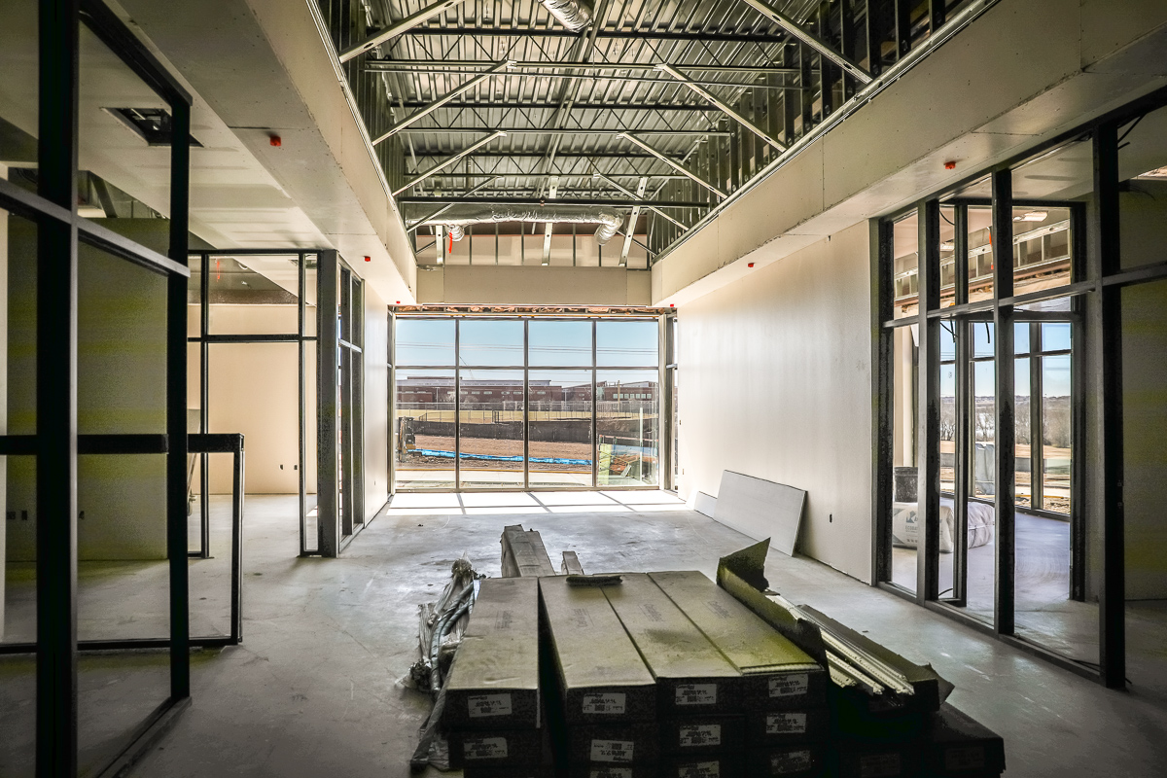
Glass framing is being installed in Area C.

Slide 4
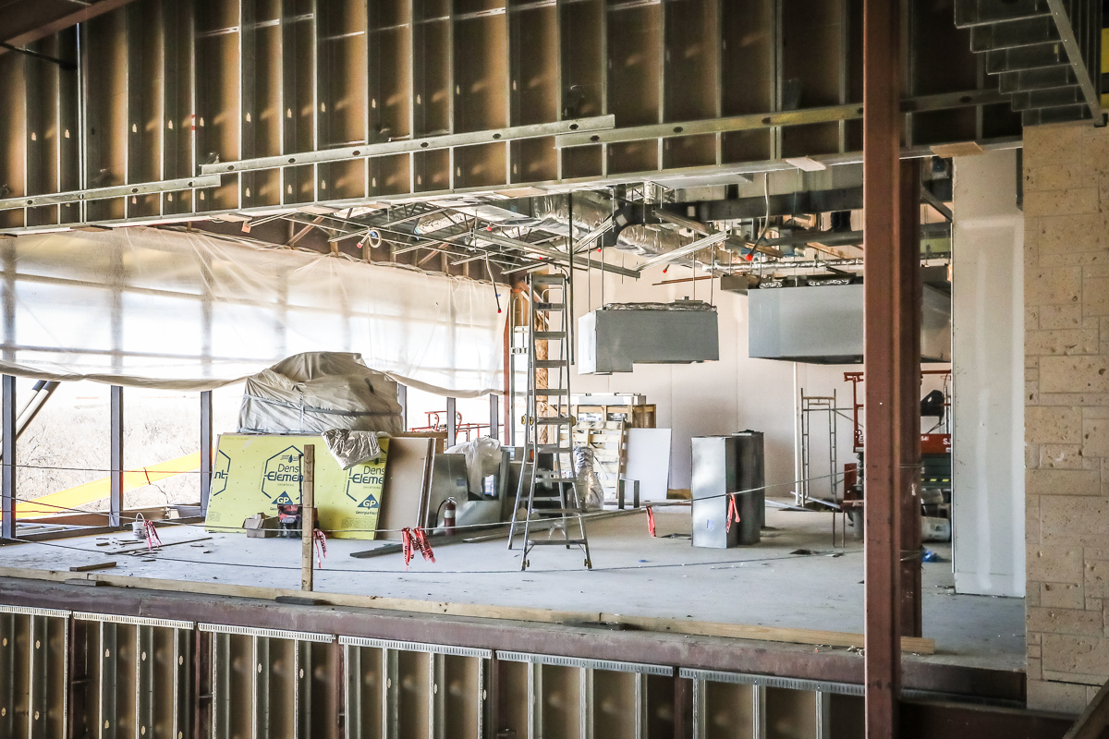
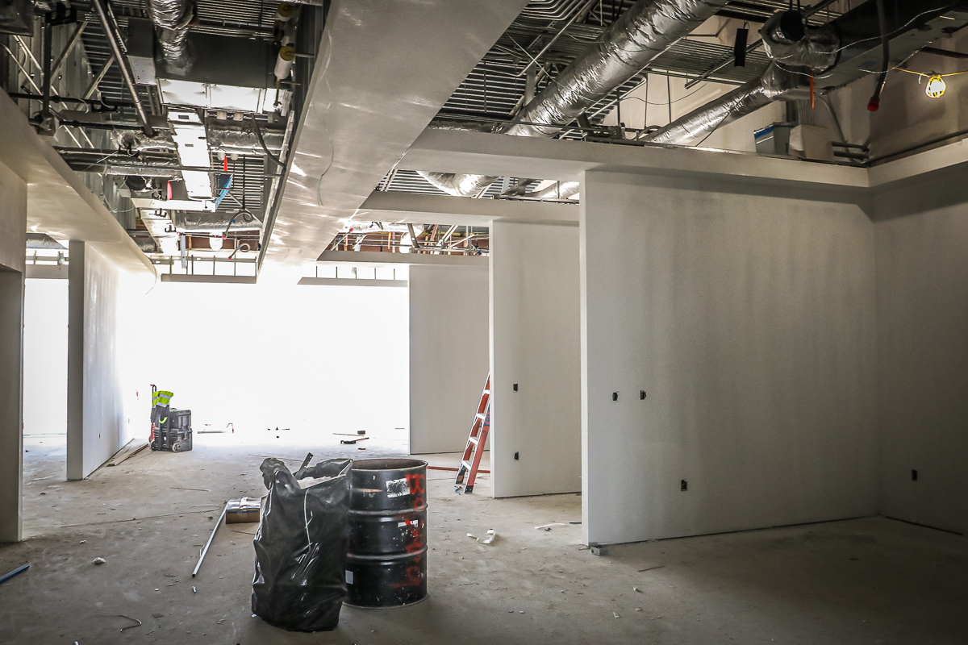
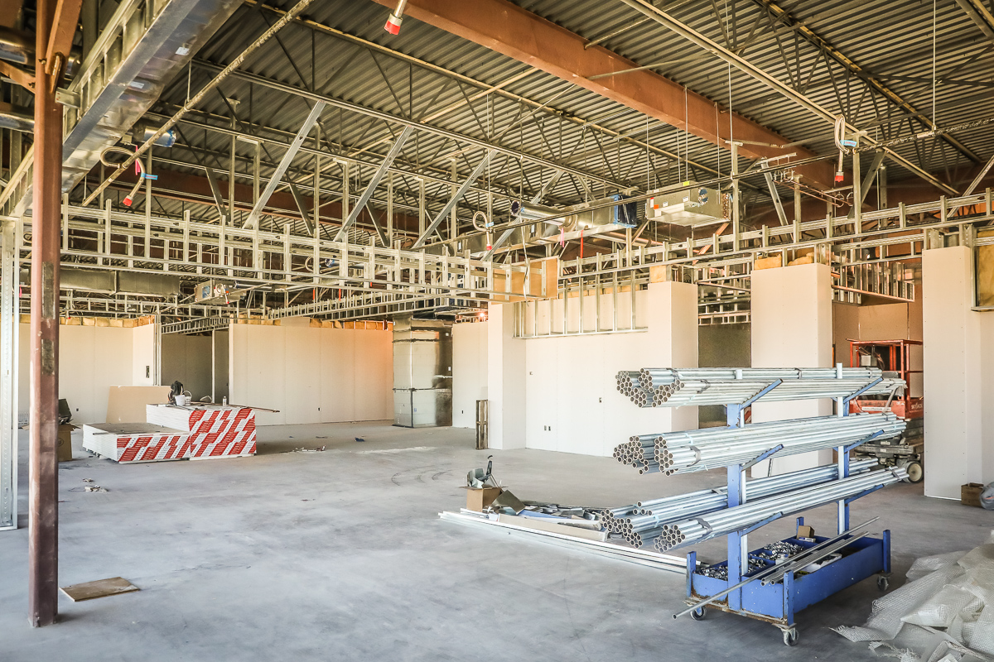
Sheetrock continues in Area B on the 2nd floor.

Slide 5
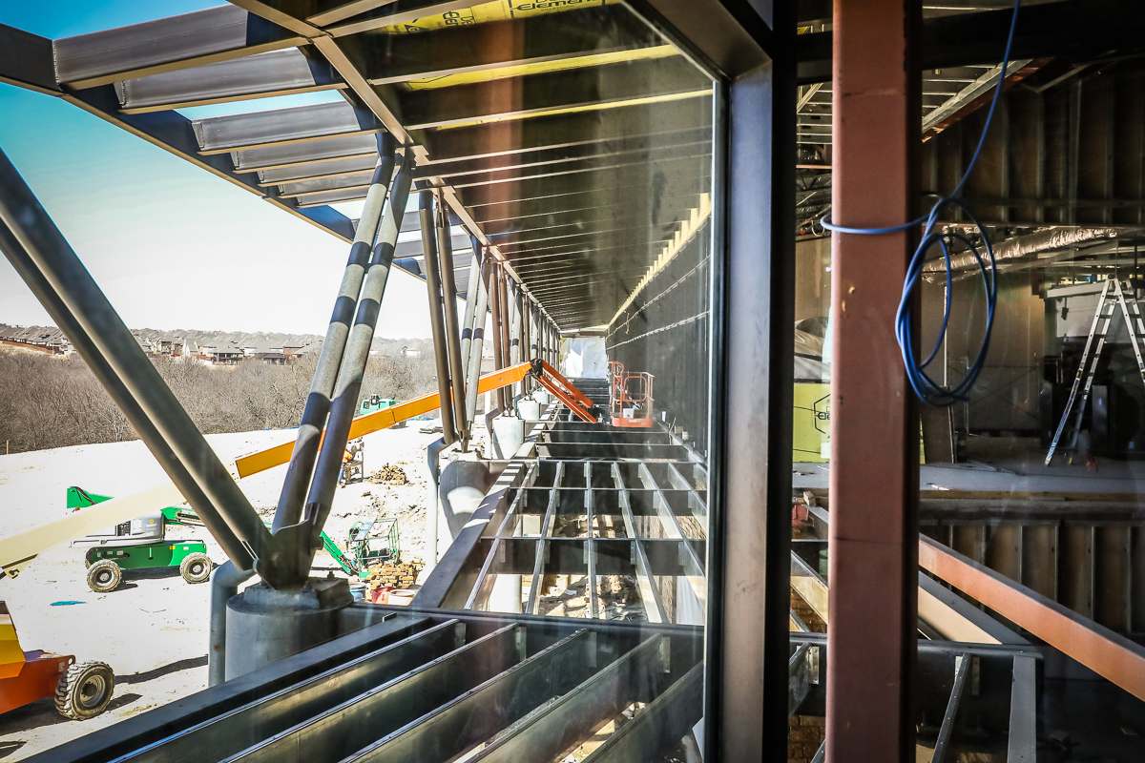
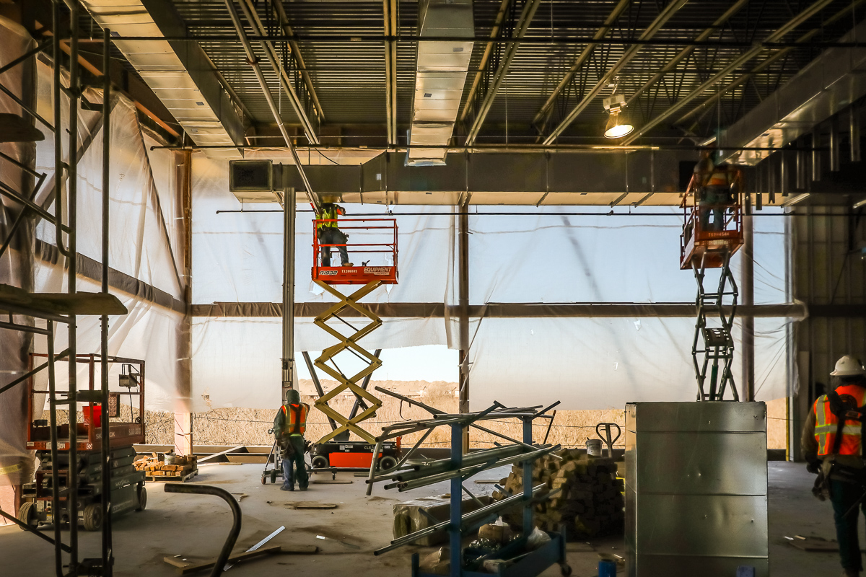
Construction of the back walkway is in progress. Mechanical duct work is being installed in Area C.

Slide 6
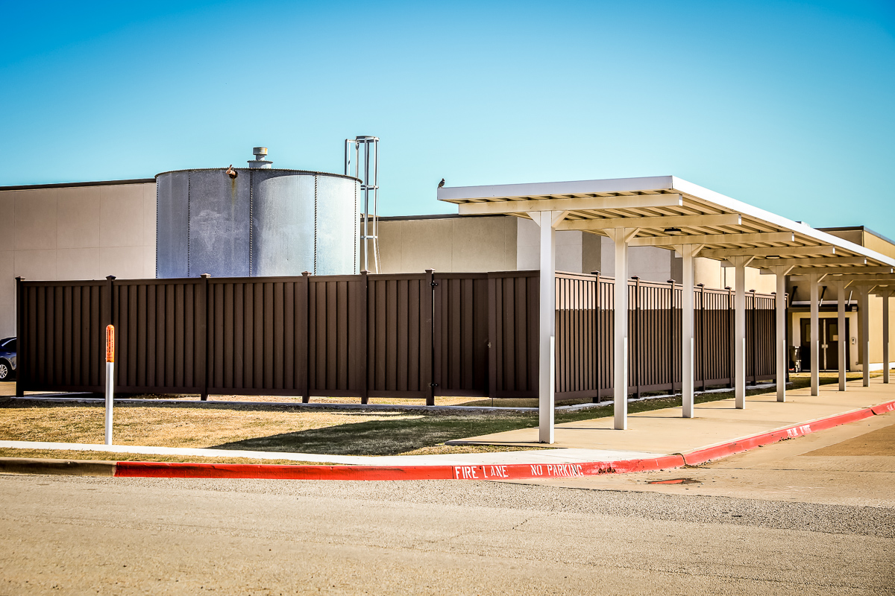
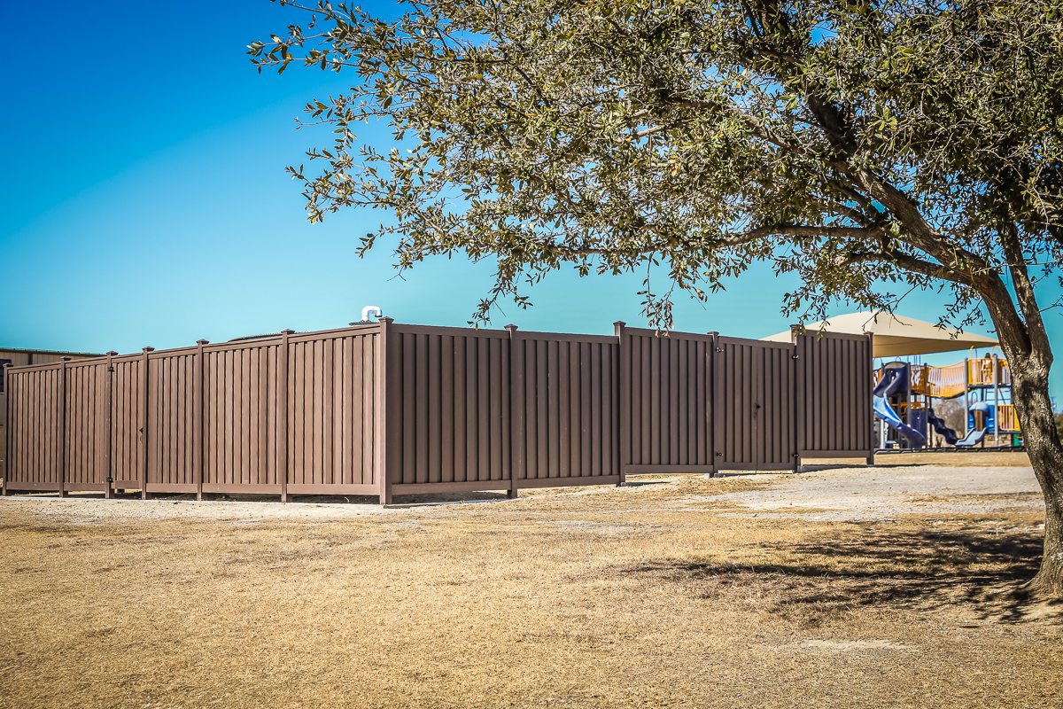
Eagle Mountain ES and Elkins ES
New fencing is complete around well fixtures at Eagle Mountain ES and Elkins ES.

